Slide 1

Presentation
on
“ Sign Language Detection ”
Presented by:
Ms. Pallavi Maske Ms. Sonali Patil
Ms. Achal Butke Mr. Chandrakant Prajapati
IT VII Sem
Guided by:
Prof. Priyanka Kanuje
Department of Information Technology
TULSIRAMJI GAIKWAD-PATIL COLLEGE OF ENGINEERING & TECHNOLOGY, NAGPUR
Session 2022-2023

Slide 2

Contents
Introduction
Aim and Objective
Software and Hardware
Literature Survey
Existing Model
Proposed Model
Module
Data Flow
Implementation
Working Module
Advantages
References
Conclusion

Slide 3
Introduction
Sign language is a visual means of communicating through hand signals, gestures, facial expressions, and body language.
It’s the main form of communication for the Deaf and Hard-of-Hearing community.
People with disabilities including Autism, Apraxia of speech, Cerebral Palsy, and Down Syndrome may also find sign language beneficial for communicating.
During the conversation between a deaf and a normal person, the deaf can comfortably converse through his/her sign language and the normal can use the sign language predictor to understand what the other person is trying to say.

Slide 4
Aim and Objective
Aim :
To build a model which can detected the sign language and convert it into the text format.
Objective :
Most of the people don’t understand the sign language as it is not a very common way of conversing.
The conversation between the deaf and other population becomes difficult.

Slide 5
Software and Hardware
Software Requirements:
Language : Python
Framework : Tensor Flow , Open CV
Development Tool : PyCharm
OS Environment: Windows 11
Hardware Requirement :
Laptop or PC 8GB RAM ,
Graphics Card – 6GB , ROM – 1060TB
HD Webcam

Slide 6
Literature Survey
Sr No. | Title of the paper | Authors | Year/ISSN No./Volume Number | Proposed Concept and Details
1. | Indian Sign Language Recognition Using ANN And SVM Classifiers | Miss. Juhi Ekbote, Mrs. Mahasweta Joshi | 2017/978-1-5090-3294-5/17 | The SVM and ANN technology is used for the gesture recognition. The SVM is used to create the model and the ANN classifier is used to perform the acknowledgement.
2. | Indian Sign Language Translator Using Gesture Recognition Algorithm | Purva C. Badhe, Vaishali Kulkarni | 2015/978-1-4673-7437-8/15 | Gesture means the motion made by limbs or hands to express any feelings. The ISL translator translates the gestures to a understandable form.

Slide 7
Existing Model
There are models present in the market for detecting the gestures for the sign language interpretation.
They are either using the SVM and ANN classifier for the model creation and for the acknowledgement. This gives the model to learn through the artificial neural system.
The models are also created with the help of gesture recognition and the ISL translator.

Slide 8
Proposed Model
In this proposed project we will be building a recognition model.
For this we will be collecting the images for deep learning using webcam and OpenCV.
We will label the images for the sign language detection using Labelling.
Setting up TensorFlow Object Detection Pipeline Configuration.
Creating the deep learning model using transfer learning.
Detecting sign language in the real time using OpenCV.

Slide 9
Data Flow Diagram
Start
Dataset Creation
Model Creation
Palm Detection
Gesture Detection
End

Slide 10
Modules
1
2
3
Collecting Images And Labelling For Object Detection
Training Tensor flow for sign language
Detecting Sign Language in real time

Slide 11
Implementation

Slide 12
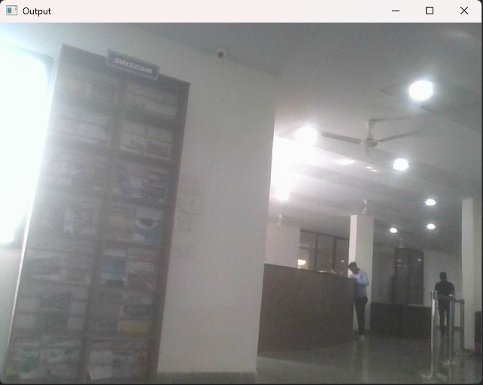
Working Module

Slide 13
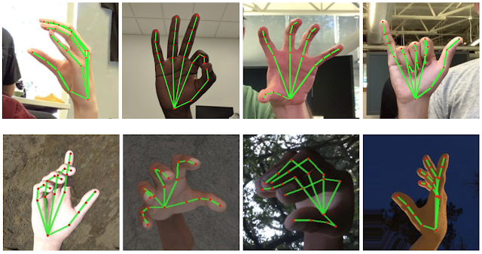
Working Module

Slide 14
Advantages
The purpose of sign language detection system is to provide an efficient and accurate way to convert sign language into text messages.
The system has a huge future scope as it make communication more efficient and easier.
If the entire project is developed in Raspberry Pie computer , which is very small yet powerful computer, the entire system becomes portable and can be taken anywhere.
This feature facilitates the user to take system anywhere and everywhere and overcomes the communication barrier.
As the system does not contain any special type of sensors, the system is less likely to get damaged.

Slide 15
Reference
J. Ekbote and M. Joshi, "Indian sign language recognition using ANN and SVM classifiers", 2017 IEEE International Conference on Innovations in Information, Embedded and Communication Systems (ICIIECS) 2017
P. C. Badhe and V. Kulkarni, "Indian sign language translator using gesture recognition algorithm," 2015 IEEE International Conference on Computer Graphics, Vision and Information Security (CGVIS), Bhubaneswar, 2015, pp. 195-200
Nimisha K P and A. Jacob, "A Brief Review of the Recent Trends in Sign Language Recognition" 2020, IEEE International Conference on Communication and Signal Processing (ICCSP), 978-1-7281-4988-2/20
Renju P B and Kausik, "Hand Gesture Recognition using Deep Root Nodal Architecture", 2019 IEEE 978-1-7281-0089-0/19

Slide 16
Reference
T. Daphne, M. Kevin, " Implementing Gesture Recognition in a Sign Language Learning Application ", IEEE 2020 Iris Signals and Systems Conference (ISSC) .
S. Nikam and A. G. Ambekar, "Sign Language Recognition using Image Based Hand Gesture Recognition Techniques " ,2016 Online International Conference on Green Engineering and Technologies (IC-GET)
M. Al-Had G. Muhammad, W. Abdul M Alan T. S. Abayes I Make, M. A. Makhoshe "Deep Lang-Based Approach for Sug Language Gestare Rog with Efficient Hund Get Reperemation 2020 IEEE ACCET
[MJN K. Bhayit. Viss Y Rathe GN. "Indian Sign Lange Gen Recognition ng Image Png and Deep Learning 2019, IEEE 978-1- 7281-3457-29 K Bhop Vis Y Ratna G N. "Indian Sign Language Gesture Recognition at Image Pincewing and Demp Learning 2019 IEEE 978-1-7283-3857-29

Slide 17
Conclusion
We are here trying to build a model which can directly convert the sign language to the text form.
The main aim of this recognition system is to enchance the human machine interaction.
In the recent years there has been development in the area of static hand gesture.

Slide 18
THANK YOU

